Slide 1
CS2100 Tutorial 4
Song Kai
song.kai@u.nus.edu

Slide 2
Addressing Mode
Methods to specify the location of a value as operand
Immediate addressing: give the value immediately.
addi $t1, $t2, 10
Register addressing: value stored in a register
add $t1, $t2, $t3
Displacement addressing: combine base and a displacement value to get address.
lw $t1, 4($t2)
PC-relative addressing: calculate address relatively from PC value
beq $t1, $2, label
Peudo-direct addressing: Obtain full target address from instruction and (PC+4)
j target

Slide 3
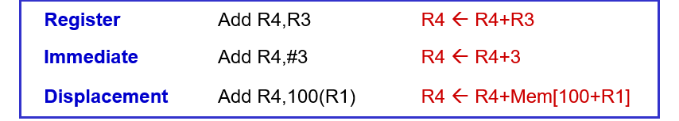
Qn 1 Instruction Formats
$s0 = 100 mem (100) = 1000
$s1 = 160 mem (160) = 1600
$s2 = 200 mem (200) = 2000
$s3 = 240 mem (240) = 2400
$s4 = 300 mem (300) = 3000
$t0 = 10000 mem (10000) = 100
$t1 = 15000 mem (15000) = 150
$t2 = 20000 mem (20000) = 200
$t3 = 25000 mem (25000) = 250
$t4 = 30000 mem (30000) = 300
(a) op $t1, $t2
Operand | Target Memory Address | Content
$t1 | NA | 15000
$t2 | NA | 20000
Notes:
Register addressing: value stored in a register

Slide 4
Qn 1 Instruction Formats
$s0 = 100 mem (100) = 1000
$s1 = 160 mem (160) = 1600
$s2 = 200 mem (200) = 2000
$s3 = 240 mem (240) = 2400
$s4 = 300 mem (300) = 3000
$t0 = 10000 mem (10000) = 100
$t1 = 15000 mem (15000) = 150
$t2 = 20000 mem (20000) = 200
$t3 = 25000 mem (25000) = 250
$t4 = 30000 mem (30000) = 300
(b) op $s2, 100($zero)
Operand | Target Memory Address | Content
$s2 | NA | 200
100($zero) | 100 | 1000
Notes:
Displacement - combine base and a displacement value to get address.
Base – displacement mode
Base register – immediate displacement mode
If the value is an address, we go to the address and read the value

Slide 5
Qn 1 Instruction Formats
$s0 = 100 mem (100) = 1000
$s1 = 160 mem (160) = 1600
$s2 = 200 mem (200) = 2000
$s3 = 240 mem (240) = 2400
$s4 = 300 mem (300) = 3000
$t0 = 10000 mem (10000) = 100
$t1 = 15000 mem (15000) = 150
$t2 = 20000 mem (20000) = 200
$t3 = 25000 mem (25000) = 250
$t4 = 30000 mem (30000) = 300
(c) op $t4, 40($s2)
Operand | Target Memory Address | Content
$t4 | NA | 30000
40($s2) | 240 | 2400

Slide 6
Qn 1 Instruction Formats
$s0 = 100 mem (100) = 1000
$s1 = 160 mem (160) = 1600
$s2 = 200 mem (200) = 2000
$s3 = 240 mem (240) = 2400
$s4 = 300 mem (300) = 3000
$t0 = 10000 mem (10000) = 100
$t1 = 15000 mem (15000) = 150
$t2 = 20000 mem (20000) = 200
$t3 = 25000 mem (25000) = 250
$t4 = 30000 mem (30000) = 300
(d) op $s3, 200($zero)
Operand | Target Memory Address | Content
$s3 | NA | 240
200($zero) | 200 | 2000

Slide 7
Qn 1 Instruction Formats
$s0 = 100 mem (100) = 1000
$s1 = 160 mem (160) = 1600
$s2 = 200 mem (200) = 2000
$s3 = 240 mem (240) = 2400
$s4 = 300 mem (300) = 3000
$t0 = 10000 mem (10000) = 100
$t1 = 15000 mem (15000) = 150
$t2 = 20000 mem (20000) = 200
$t3 = 25000 mem (25000) = 250
$t4 = 30000 mem (30000) = 300
(e) op $t3, $zero($t1)
Operand | Target Memory Address | Content
$t3 | NA | 25000
$zero($t1) | Illegal | Illegal
Notes:
This is base register – displacement register mode (hypothetically)

Slide 8
Qn 1 Instruction Formats
$s0 = 100 mem (100) = 1000
$s1 = 160 mem (160) = 1600
$s2 = 200 mem (200) = 2000
$s3 = 240 mem (240) = 2400
$s4 = 300 mem (300) = 3000
$t0 = 10000 mem (10000) = 100
$t1 = 15000 mem (15000) = 150
$t2 = 20000 mem (20000) = 200
$t3 = 25000 mem (25000) = 250
$t4 = 30000 mem (30000) = 300
(f) op $s1, 140($s1)
Operand | Target Memory Address | Content
$s1 | NA | 160
140($s1) | 300 | 3000

Slide 9
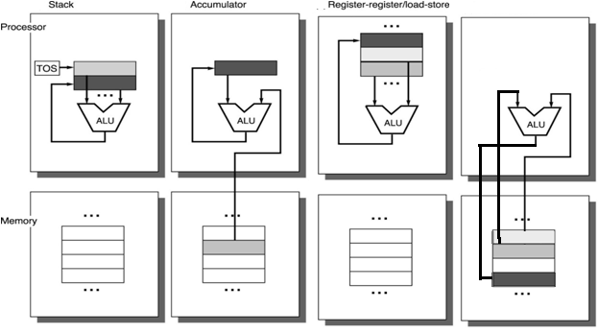
3.1 Storage Architecture: Example
Stack | Accumulator | Register (load-store) | Memory-Memory
Push A | Load A | Load R1,A | Add C, A, B
Push B | Add B | Load R2,B
Add | Store C | Add R3,R1,R2
Pop C |  | Store R3,C
Stack
Accumulator
Register-register/load-store
Memory-Memory
C = A+B

Slide 10
3.1 Storage Architecture: Animation
Stack | Accumulator | Register (load-store) | Memory-Memory
Push A | Load A | Load R1,A | Add C, A, B
Push B | Add B | Load R2,B
Add | Store C | Add R3,R1,R2
Pop C |  | Store R3,C
Push A
...
...
Push B
10
A
Add
20
B
Pop C
20
30
?
C
30
...
...
10
Stack
Memory
Variable Name
This is information remembered by the compiler.

Slide 11
3.1 Storage Architecture: Animation
Stack | Accumulator | Register (load-store) | Memory-Memory
Push A | Load A | Load R1,A | Add C, A, B
Push B | Add B | Load R2,B
Add | Store C | Add R3,R1,R2
Pop C |  | Store R3,C
Load A
...
...
Add B
10
A
Store C
20
B
30
?
C
30
...
...
?
10
Accumulator
Memory
Variable Name
This is a special register!
This is information remembered by the compiler.

Slide 12
3.1 Storage Architecture: Animation
Stack | Accumulator | Register (load-store) | Memory-Memory
Push A | Load A | Load R1,A | Add C, A, B
Push B | Add B | Load R2,B
Add | Store C | Add R3,R1,R2
Pop C |  | Store R3,C
Load R1,A
...
...
...
...
Load R2,B
?
10
R1
10
A
Add R3,R1,R2
?
20
R2
20
B
Store R3,C
?
30
R3
30
?
C
...
...
...
...
Registers
Memory
Variable Name
These are general purpose registers
This is information remembered by the compiler.
Notes:
This is actually Register-Register

Slide 13
3.1 Storage Architecture: Animation
Stack | Accumulator | Register-Memory | Memory-Memory
Push A | Load A | MOV R1,[A] | Add C, A, B
Push B | Add B | ADD R1,[B]
Add | Store C | MOV [C], R1
Pop C
MOV R1, [A]
...
...
...
...
ADD R1, [B]
30
?
R1
10
A
10
MOV [C], R1
20
B
?
C
30
...
...
...
...
Registers
Memory
Variable Name
These are general purpose registers
This is information remembered by the compiler.
Notes:
Register-Memory taking reference from X86
Move the value at the latter to the former
Instead of loading values from address into registers for further processing, we can directly perform calculations from the value at the address

Slide 14
3.1 Storage Architecture: Animation
Stack | Accumulator | Register (load-store) | Memory-Memory
Push A | Load A | Load R1,A | Add C, A, B
Push B | Add B | Load R2,B
Add | Store C | Add R3,R1,R2
Pop C |  | Store R3,C
Add C, A, B
...
...
10
A
20
B
30
?
C
...
...
Memory
Variable Name
This is information remembered by the compiler.

Slide 15
Qn 2 Instruction Set Architectures
Stack
a0 = a1 + a2
a1 = a0 + a2
a2 = a0 + a1
push @a1
push @a2
add
pop @a0
Top of stack
Older Value
Older Value
Older Value
Older Value
•
•
•

Slide 16
Qn 2 Instruction Set Architectures
Stack
a0 = a1 + a2
a1 = a0 + a2
a2 = a0 + a1
Top of stack
Older Value
Older Value
push @a0
push @a2
add
pop @a1
Older Value
Older Value
•
•
•

Slide 17
Qn 2 Instruction Set Architectures
Stack
a0 = a1 + a2
a1 = a0 + a2
a2 = a0 + a1
Top of stack
Older Value
Older Value
Older Value
Older Value
push @a0
push @a1
add
pop @a2
•
•
•

Slide 18
Qn 2 Instruction Set Architectures
Accumulator
a0 = a1 + a2
a1 = a0 + a2
a2 = a0 + a1
load @a1
add @a2
store @a0
Accumulator
Old Value

Slide 19
Qn 2 Instruction Set Architectures
Accumulator
a0 = a1 + a2
a1 = a0 + a2
a2 = a0 + a1
Accumulator
Value @a0
add @a2
store @a1
Notes:
The optimization is not compulsory

Slide 20
Qn 2 Instruction Set Architectures
Accumulator
a0 = a1 + a2
a1 = a0 + a2
a2 = a0 + a1
Accumulator
Value @a1
add @a0
store @a2

Slide 21
Qn 2 Instruction Set Architectures
Memory-Memroy
a0 = a1 + a2
a1 = a0 + a2
a2 = a0 + a1
add @a0, @a1, @a2
add @a1, @a0, @a2
add @a2, @a0, @a1

Slide 22
Qn 2 Instruction Set Architectures
Register-Register
a0 = a1 + a2
a1 = a0 + a2
a2 = a0 + a1
a0 → $r0
a1 → $r1
a2 → $r2
load $r1, @a1
load $r2, @a2
add $r0, $r1, $r2
store $r0, @a0
add $r1, $r0, $r2
store $r1, @a1
add $r2, $r0, $r1
store $r2, @a2

Slide 23
Qn 3 Instruction Design
Constraints:
16-bit processor
3 bits opcode
128 bytes of byte-addressable memory
5 registers
Fixed-length instructions
Instruction length should be multiples of 2 bytes
7-bit address for 128 locations
3-bit register code for 5 registers
Notes:
design a dedicated 16-bit processor: the processor handles data / instruction in 16 bits each time. It is ideal to have instructions to be in multiples of 16 bits to align data bus, memory and register operations
Fixed-length instructions means that all instructions should be as long as the longest instruction

Slide 24
Qn 3 Instruction Design
Instruction length in multiples of 2 bytes
3 bits opcode
128 bytes of memory – 7 bit
5 registers – 3 bit
Fixed length
Stack
push @src
pop @dest
add
Instruction Length
3 + 7 = 10 bit
10 bit
3 bit
2 bytes

Slide 25
Qn 3 Instruction Design
Stack
a0 = a1 + a2
a1 = a0 + a2
a2 = a0 + a1
push @a1
push @a2
add
pop @a0
12 x 2 bytes = 24 bytes
Top of stack
Older Value
push @a0
push @a2
add
pop @a1
Older Value
Older Value
Older Value
•
•
•
push @a0
push @a1
add
pop @a2

Slide 26
Qn 3 Instruction Design
Instruction length in multiples of 2 bytes
3 bits opcode
128 bytes of memory – 7 bit
5 registers – 3 bit
Fixed length
Accumulator
load @src
add @src
store @dest
Instruction Length
3 + 7 = 10 bit
10 bit
10 bit
2 bytes

Slide 27
Qn 3 Instruction Design
Accumulator
a0 = a1 + a2
a1 = a0 + a2
a2 = a0 + a1
7 x 2 bytes = 14 bytes
load @a1
add @a2
store @a0
Accumulator
Older Value
add @a2
store @a1
add @a0
store @a2

Slide 28
Qn 3 Instruction Design
Instruction length in multiples of 2 bytes
3 bits opcode
128 bytes of memory – 7 bit
5 registers – 3 bit
Fixed length
Mem-Mem
add @dest, @src1, @src2
Instruction Length
3 + 7 + 7 + 7 = 24 bit
24 / 8 = 3
↓
4 bytes

Slide 29
Qn 3 Instruction Design
Memory-Memroy
a0 = a1 + a2
a1 = a0 + a2
a2 = a0 + a1
add @a0, @a1, @a2
add @a1, @a0, @a2
add @a2, @a0, @a1
3 x 4 bytes = 12 bytes

Slide 30
Qn 3 Instruction Design
Instruction length in multiples of 2 bytes
3 bits opcode
128 bytes of memory – 7 bit
5 registers – 3 bit
Fixed length
Reg-Reg
load $reg, @src
add $dest, $src1, $src2
store $reg, @dest
Instruction Length
3 + 3 + 7 = 13 bit
3 + 3 + 3 + 3 = 12 bit
3 +3 +7 = 13 bit
2 bytes

Slide 31
Qn 3 Instruction Design
Register-Register
a0 = a1 + a2
a1 = a0 + a2
a2 = a0 + a1
a0 → $r0
a1 → $r1
a2 → $r2
load $r1, @a1
load $r2, @a2
add $r0, $r1, $r2
store $r0, @a0
add $r1, $r0, $r2
store $r1, @a1
add $r2, $r0, $r1
store $r2, @a2
8 x 2 bytes = 16 bytes

Slide 32
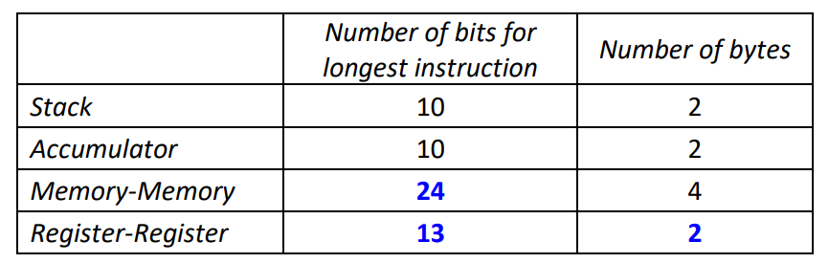
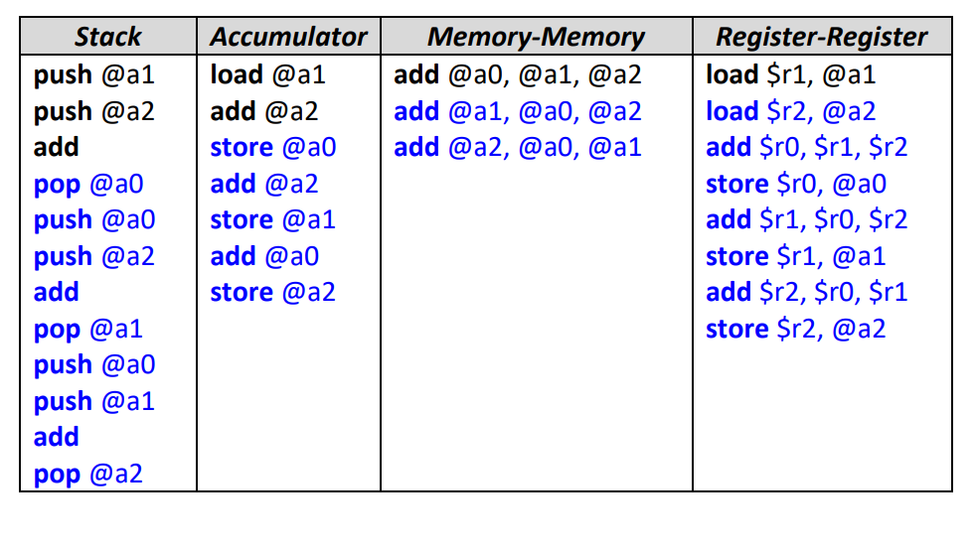
Qn 3 Instruction Design
Notes:
Memory-Memory is the most space efficient, but may not be the fastest, because each time we have to read from memory

Slide 33
Q4 ISA Instruction Counts
Constraints
16-bit instructions
5-bit addresses
2 types of instructions:
Class A: one address
Class B: two addresses
Class A:
Opcode
Address
11 bit
5 bit
Class B:
Opcode
Address
Address
6 bit
5 bit
5 bit

Slide 34
Q4 ISA Instruction Counts
Observations:
1. Opcode in Class B shouldn’t be a prefix of Class A
2. More Class B instructions → smaller total number of instructions
Class A:
Opcode
Address
11 bit
5 bit
Class B:
Opcode
Address
Address
6 bit
5 bit
5 bit

Slide 35
Q4 ISA Instruction Counts
More Class B instructions → smaller total number of instructions
Min total number of instructions
Largest number of Class B instructions
(2⁶ – 1) Class B instructions
one 6-bit prefix for Class A instructions
1 x 2⁵ Class A instructions
Total = (2⁶ – 1) + (2⁵) = 63 + 32 = 95
Class A:
Opcode
Address
11 bit
5 bit
Class B:
Opcode
Address
Address
6 bit
5 bit
5 bit
Addition

Slide 36
Q4 ISA Instruction Counts
More Class B instructions → smaller total number of instructions
Max total number of instructions
Smallest number of Class B instructions
1 Class B instructions
(2⁶ – 1) 6-bit prefix for Class A instructions
(2⁶ – 1) x 2⁵ Class A instructions
Total = 1+ (2⁶ – 1) x (2⁵) = 1 + 2016 = 2017
Class A:
Opcode
Address
11 bit
5 bit
Class B:
Opcode
Address
Address
6 bit
5 bit
5 bit
Addition

Slide 37
Q4 ISA Instruction Counts
Observations:
1. Opcode in Class B shouldn’t be a prefix of Class A
2. The presence of each Class B opcode eliminates 2¹¹⁻⁶ = 32 Class A opcode
There are 2¹¹ = 2048 Class A opcodes theoretically.
Min:
63 Class B, eliminating 63 x 32 = 2016 Class A opcodes
Total: 63 + (2048 – 2016) = 95
Class A:
Opcode
Address
11 bit
5 bit
Class B:
Opcode
Address
Address
6 bit
5 bit
5 bit
Subtraction

Slide 38
Q4 ISA Instruction Counts
Observations:
1. Opcode in Class B shouldn’t be a prefix of Class A
2. The presence of each Class B opcode eliminates 2¹¹⁻⁶ = 32 Class A opcode
There are 2¹¹ = 2048 Class A opcodes theoretically.
Max:
1 Class B, eliminating 1 x 32 = 32 Class A opcodes.
Total: 1 + (2048 – 32) = 2017
Class A:
Opcode
Address
11 bit
5 bit
Class B:
Opcode
Address
Address
6 bit
5 bit
5 bit
Subtraction

Slide 39
Backup:
Min:
Maximize A, then maximize B, leave the rest to C
A: 2⁴ – 1 = 15, leave one 4-bit prefix to B and C
B: 1 x 2⁸⁻⁴ – 1 = 15, leave one 8-bit prefix to C
C: 1 x 2¹⁰⁻⁸ = 4
Total: 15 + 15 + 4 = 34
Max:
Minimize A, then minimize B, leave the rest of C
A: 1
B: 1
Each type A eliminates 2⁸⁻⁴ = 16 type B, and 2¹⁰⁻⁴ = 64 type C
Each type B eliminates 2¹⁰⁻⁸ = 4 type C
C: 2¹⁰ – 1 x 64 – 1 x 4 = 956
Total: 1 + 1 + 956 = 958
Type A: 4-bit opcode
Type B: 8-bit opcode
Type C: 10-bit opcode
Find min and max number of instructions (with at least one instruction of each type).
Min: addition
Max: subtraction
Notes:
0000 to A
0001 – 1111 to B and C
0001 0000 to B
0001 0001 – 0001 1111 to C, there are 15 x 4 = 60
The rest 4-bit prefix 0010 – 1111 are all for C, 14 x 64 = 896
A eliminate B is not used since we are guaranteed to have at least one type B. Still good to have a sanity check.

Slide 40
Illustration
Type A: 4-bit opcode
Type B: 8-bit opcode
Type C: 10-bit opcode
Min: 34
2⁴ – 1= 15
Type A:
0000 to 1110
Other fields
0
4
1 x (2⁴ – 1)= 15
Type B:
1111
0000 to 1110
Other fields
0
4
8
1 x 1 x 2² = 4
Type C:
1111
1111
00 to 11
Other fields
0
4
8
10
Addition

Slide 41
Illustration
Type A: 4-bit opcode
Type B: 8-bit opcode
Type C: 10-bit opcode
Min: 34
2⁴ – 1= 15
Type A:
0000 to 1110
Other fields
0
4
1 x (2⁴ – 1)= 15
Type B:
1111
0000 to 1110
Other fields
0
4
8
1 x 1 x 2² = 4
Type C:
1111
1111
00 to 11
Other fields
0
4
8
10
Subtraction:
Maximize A, then maximize B, leave the rest to C
Each type A eliminates 2⁸⁻⁴ = 16 type B, and 2¹⁰⁻⁴ = 64 type C
Each type B eliminates 2¹⁰⁻⁸ = 4 type C
A: 2⁴ – 1 = 15
B: 2⁸ – 15 x 16 – 1 = 15
C: 2¹⁰ – 15 x 64 – 15 x 4 = 4

Slide 42
Illustration
Type A: 4-bit opcode
Type B: 8-bit opcode
Type C: 10-bit opcode
Max: 958
1
Type A:
0000
Other fields
0
4
1 x 1 = 1
Type B:
0001
0000
Other fields
0
4
8
1 x (2⁴ – 1) x 2² = 60
Type C:
0001
0001 to 1111
00 to 11
Other fields
0
4
8
10
(2⁴ – 2) x 2⁶ = 896
Type C:
0010 to 1111
000000 to 111111
Other fields
0
4
10
Addition

Slide 43
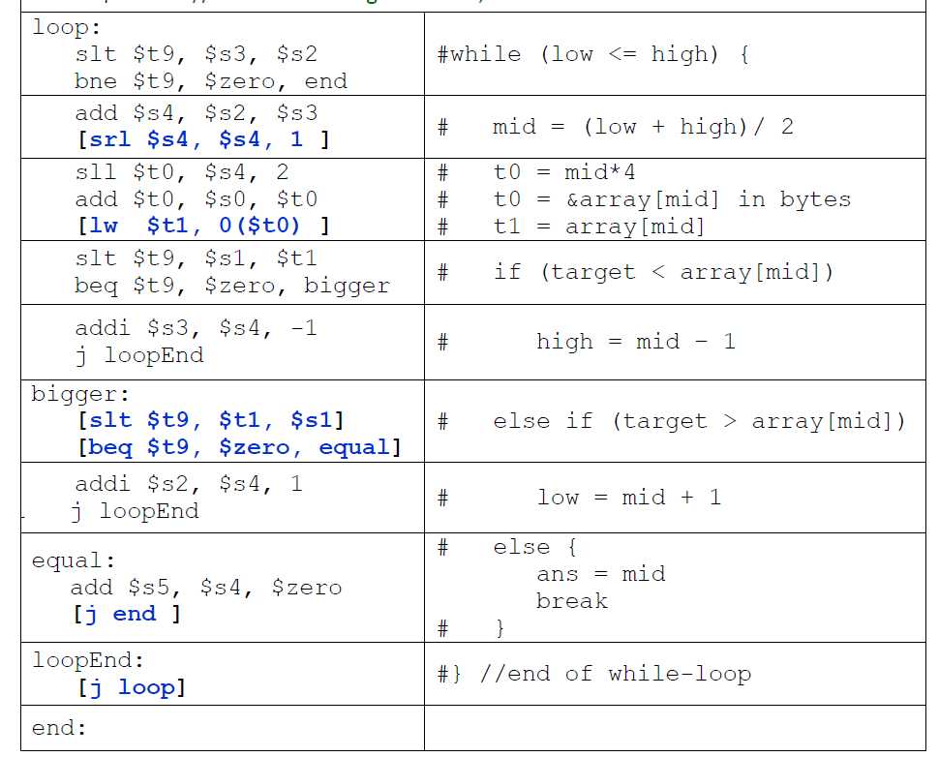
Backup: C to MIPS
smaller: if (target < array[mid]):
finish smaller branch, skip the rest
else:
bigger: if (target > array[mid])
finish bigger branch, skip the rest
equal: else:
finish equal branch
Step 1: Rewrite
smaller: if not (target < array[mid]):
jump to bigger
(else:)
finish smaller branch, skip the rest
bigger: if not (target > array[mid]):
jump to equal
(else:)
finish bigger branch, skip the rest
equal: finish equal branch
Step 2: Determine the conditions
slt to check target < array[mid],
we need it to be false (0) to jump
target > array[mid] is equivalent to array[mid] < target
we need it to be false (0) to jump
Digression: if we need a condition to be true (not 0), we use bne $t1, $0, label instead ☺

Slide 44
CS2100 Tutorial 4
Song Kai
song.kai@u.nus.edu

